Slide 1
Product Demand Forecasting Model
Written By | Mohammad Danish

Slide 2
Objective:
“A private limited company is planning to offer some discounts during diwali period. The company wants to find the price at which its product can be a better deal compared to its competitors. For this task, the company provided a dataset of past changes in sales based on price changes. You need to train a model that can predict the demand for the product in the market with different price segments.
Benefits:
Detection the features heavily responsible for Actual product demand.
Gives better insight between the Actual Product demand and the product Sold.
To give the better deal to the customer as compared to competitors .

Slide 3
Data Description
Given is the variable name, variable type, the measurement unit, and a brief description. The concrete compressive strength is the regression problem. The order of this listing corresponds to the order of numerals along the rows of the database.
Column Name | Data Type | Description
Shop Id | integer | Unique Shop ID
Discount Price | Float | Discounted Price of Product
Base Price | Float | Base price of Product
Item Sold | integer | Number of items Sold against a specific Shop Id

Slide 4
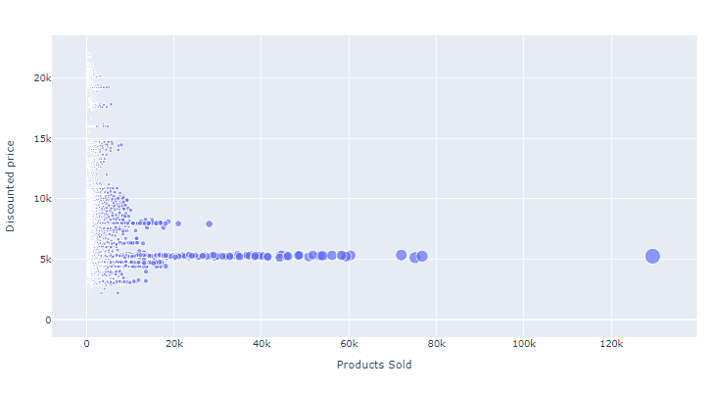
1. Data Insertion
Data has call into the Jupyter notebook from Excel file and convert into Pandas DataFrame.
2. Data preprocessing
Data Preprocessing we check the Any null value is there or not?.
In given Data Set there has been no null value to fill.
3. Data Visualization
We can see that most of the data points show the sales of the product is increasing as the price is decreasing with some exceptions through Data Visualization Technique.

Slide 5
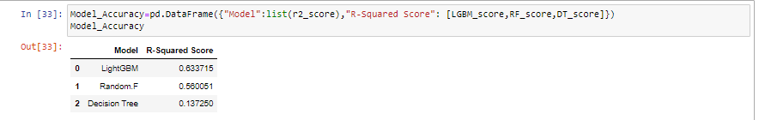
4. Parameter tunning:
Three algorithms are used in this problem Light GBM, Random Forest and Decision Tree. The parameters of all these 3 algorithms are tunned and passed into the model.
5. Model building:
After doing all kinds of preprocessing operations, data set is passed into all Three models Light GBM, Random Forest and Decision Tree. It was found that LightGBM performs best with highest R2 score equals to 0.63. So ‘LightGBM’ performed well in this problem.

Slide 6
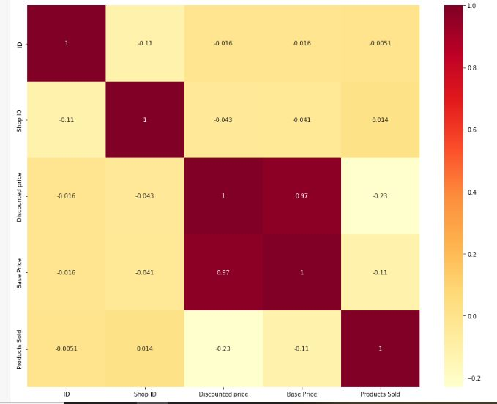
Observations
Correlation is used to understand the relation between a target variable and predictors. In this the target variable Product Sold and its correlation with other variables is observed.
Base price is positively correlated with Discount Price , which indicates that the Base price & Discount price plays an important factor in Product. Where as Shop ID doesn’t play any role in Product Sold because it don’t Highly Correlated with Base Price Or Discount Price

Slide 7
Conclusion
Base Price is one of the essential factors that affect the demand for the product. Only a few people will buy the product ,if the price increases.
THE END

